Slide 1

Evaluation Metrics

Slide 2
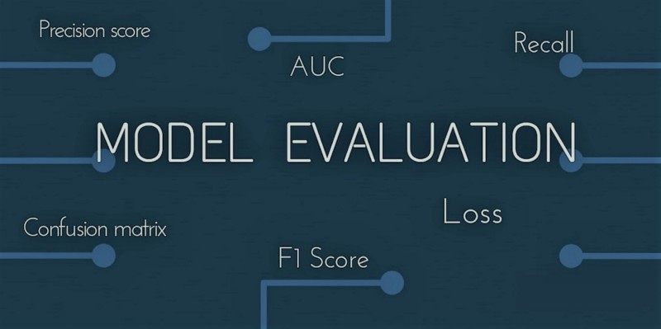
What are Evaluation Metrics?
Evaluation metrics are used to measure the quality of the statistical or machine learning model. It’s about creating and selecting a model which gives high accuracy on out of sample data. Hence, it is crucial to check the accuracy of your model before computing predicted values. Evaluation metrics help in explaining the performance of a model.

Slide 3
Binary Classification
Binary classification refers to those classification tasks that have two class labels. Binary classification tasks involve one class that is the normal state and another class that is the abnormal state.
Examples include:
- Email spam detection (spam or not).
- Conversion prediction (buy or not).

Slide 4
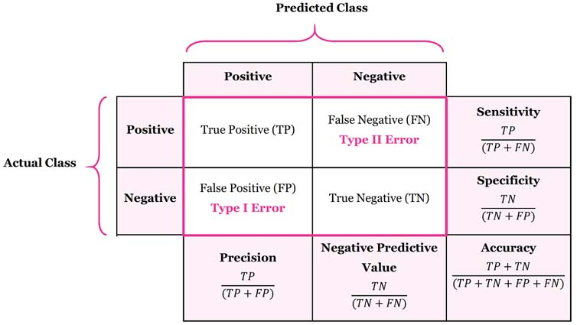
1) Confusion Matrix
Accuracy : the proportion of the total number of predictions that were correct.
Positive Predictive Value or Precision : the proportion of positive cases that were correctly identified.
Negative Predictive Value : the proportion of negative cases that were correctly identified.
Sensitivity or Recall : the proportion of actual positive cases which are correctly identified.
Specificity : the proportion of actual negative cases which are correctly identified.

Slide 5
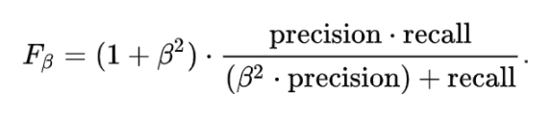
2) F Beta Score
F Beta measures the effectiveness of a model with respect to a user who attaches β times as much importance to recall as precision.
Sometimes we need to get the best precision and recall at the same time. For this case we use F Beta Score.

Slide 6
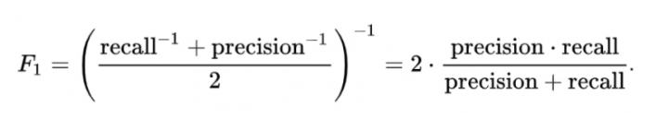
Our main aim is to calculate the Beta Value.
β = 1; When Precision and Recall are both equally important
β = 0.5; When Precision has more impact than Recall
β > 1; When Recall has more impact than Precision

Slide 7
Linear Regression
Linear Regression is the supervised Machine Learning model in which the model finds the best fit linear line between the independent and dependent variable i.e, it finds the linear relationship between the dependent and independent variable.
Linear Regression is of two types: Simple and Multiple.
Simple Linear Regression is where only one independent variable is present and the model must find the linear relationship of it with the dependent variable
Whereas, In Multiple Linear Regression there are more than one independent variables for the model to find the relationship.

Slide 8

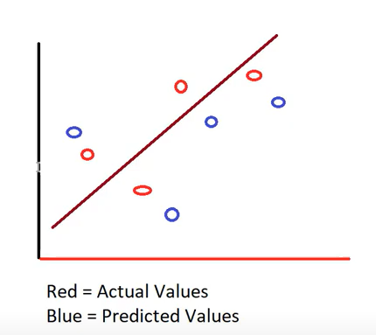
The difference between actual and predicted values.
Best Fit
(y)
(^y)

Slide 9
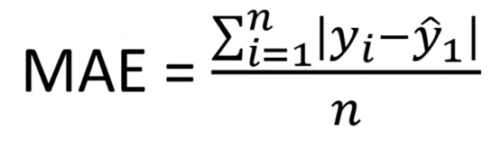
1) Mean Absolute Error
Mean absolute error is the sum of absolute/positive errors of all values. MAE is the sum of absolute differences between actual and predicted values. It doesn’t consider the direction, that is, positive or negative.
When we consider directions also, that is called Mean Bias Error (MBE), which is a sum of errors(difference).

Slide 10
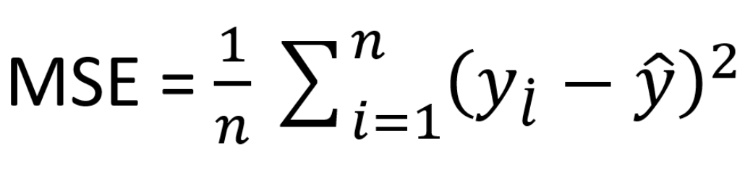
2) Mean Square Error
Mean square error is always positive and a value closer to 0 or a lower value is better. If we were to run a model with different parameters/independent variables, model with lower MSE will be deemed better.

Slide 11
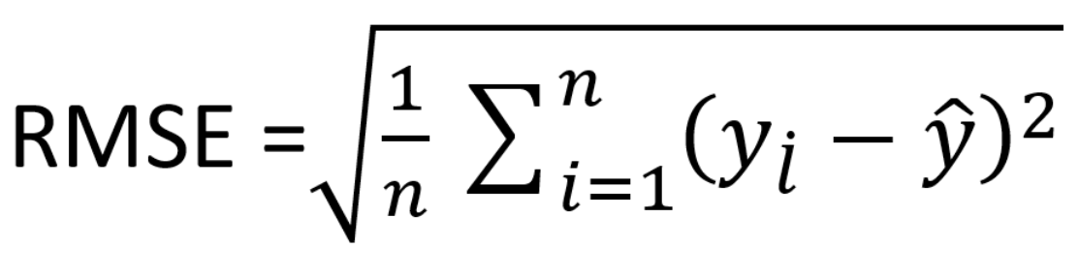
3) Root Mean Square Error
Square root of MSE yields root mean square error (RMSE). It is the standard deviation of error (residual error).
It indicates the spread of the residual errors. It is always positive, and a lower value indicates better performance. Ideal value would be 0 but it is never achieved.
Effect of each error on RMSE is directly proportional to the squared error therefore, RMSE is sensitive to outliers and can exaggerate results if there are outliers in the data set.
As compared to mean absolute error, RMSE gives higher weightage and punishes large errors.

Slide 12
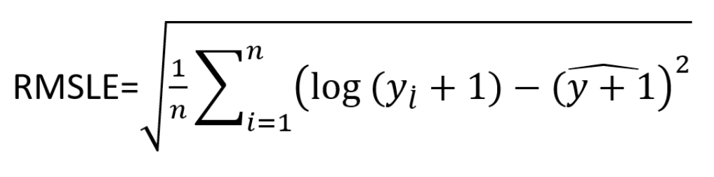
4) Root Mean Squared Log Error
Root mean squared log error is basically RMSE but calculated at logarithmic scale.
While calculating RMSLE, 1 is added as constant to actual and predicted values because they can be 0 and log of 0 is undefined. Overall formula remains same.

Slide 13
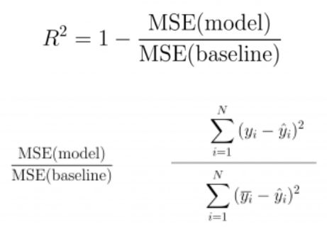
5) R-Squared
MSE(model): Mean Squared Error of the predictions against the actual values
MSE(baseline): Mean Squared Error of mean prediction against the actual values
We get the values between 0 and 1. Value closer to 1, yields the better fitting line.

Slide 14
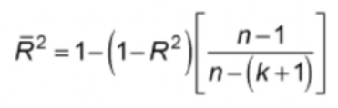
Adjusted R-Squared
A model performing equal to baseline would give R-Squared as 0. Better the model, higher the R2 value. The best model with all correct predictions would give R-Squared as 1. However, on adding new features to the model, the R-Squared value either increases or remains the same. R-Squared does not penalize for adding features that add no value to the model. So, an improved version over the R-Squared is the adjusted R-Squared.
k: number of features
n: number of samples

Slide 15
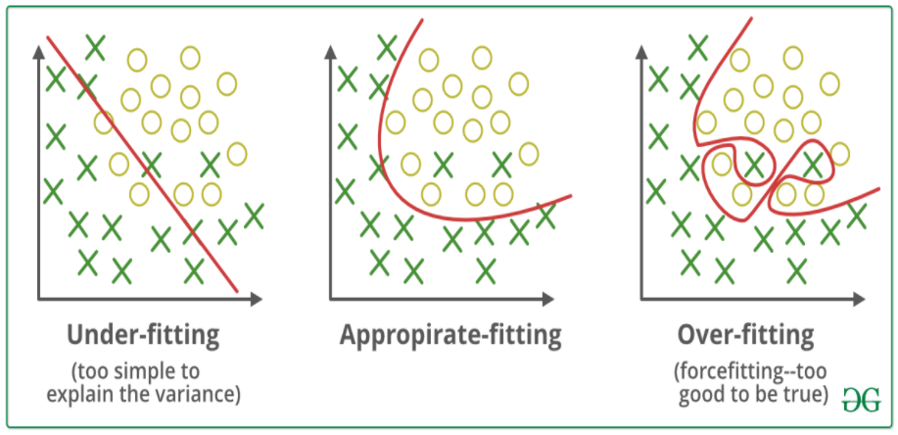
Bias Variance

Slide 16
